Slide 1
Middle Layer Services at NSLS II for Beam Commissioning and Operation
Guobao Shen
Controls Group, Photon Sciences
Brookhaven National Laboratory
Feb, 2014

Slide 2
Content
NSLS II Overview
NSLS II Control Brief
Virtual Accelerator
EPICS V4 based Middle Layer Service
RESTful based Middle Layer Services
Beam Commissioning
NSLS II Construction
Conclusion

Slide 3
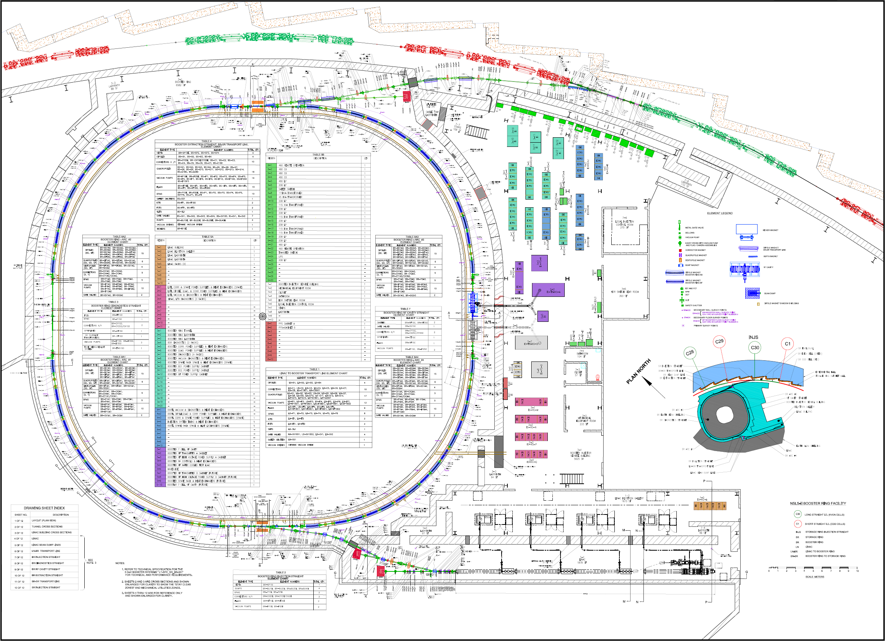
NSLS II Overview
Injection system
Turn key: LINAC & Booster
Injection Straight Section
BST: 50nm-rad
0.1% energy spread
8nC/sec
3-GeV booster, C=158m
20 mA, 1 Hz, 40 nm⋅rad
LBT: 150nm-rad (4σ_{x}σ_{x’})
0.5% energy spread
Single bunch 0.5nC/sec
Multibunch (15nC/sec, 80~150)
200-MeV linac
15 nC/160-300 ns,
0.5% e.s., 50 µm⋅rad

Slide 4
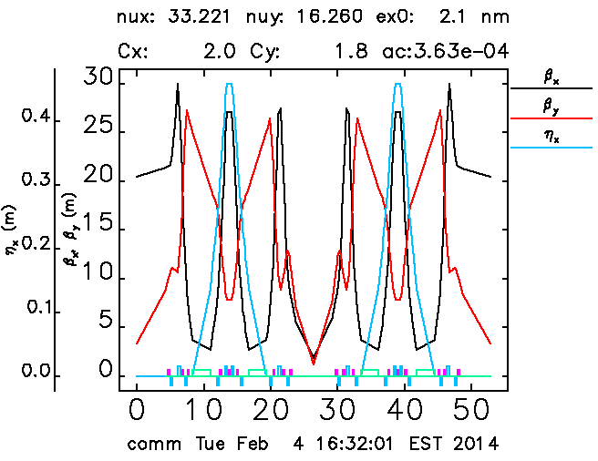
NSLS II Overview
Storage ring parameters
30 Cell DBA lattice structure
Beam Specifications
Energy | 3.0 GeV
Circumference | 792 m
Number of Periods | 30 DBA
Straights | 6.6/9.3 m
Emittance (h,v) | < 1/0.008 nm
Momentum Compaction | 0.00037
Dipole Bend Radius | 25 m
Energy Loss per Turn | <2 MeV
Energy Spread | 0.09%
RF Frequency | 500 MHz
Harmonic Number | 1320
RF Bucket Height | >2.5%
RMS Bunch Length | 15-30 ps
Average Current | 500 mA
Current per Bunch | 0.5 mA
Charge per Bunch | 1.2 nC
Touschek Lifetime | > 3hrs
Courtesy of Weiming Guo

Slide 5
NSLS II Controls Brief
System Architecture
CS-Studio
pvManager
CAC PVAC REST
Python Apps
CAC PVAC REST
MMLT
CAC PVAC REST
Matlab Apps
CAC PVAC REST
Channel Arch
CAC PVAC REST
Ethernet
EPICS V4
MASAR
Python
PVAS
HTTP/REST
MUNICONV
Python
PVAS
HTTP/REST
Lattice/Model
Python
PVAS
HTTP/REST
Channel Finder
Java
SQLite/IRMIS
MySQL/IRMIS
MySQL/IRMIS
MySQL
Distributed Front-Ends
CAS PVAS
Diag db
CAS PVAS
PS db
CAS PVAS
RF db
CAS PVAS
VA db
CAS
JMS Service
Physical Device
Physical Device
Physical Device
Physical Device
Tracy-III Simulation

Slide 6
NSLS II Controls Brief
Control room software
Debian/Linux 7 consoles
4 for general operator and 1 for lead operator
Python cothread for channel access
Version 2.8/Python 2.7
Dedicated matlab server
3 for physicist
1 for BPM expert
labCa 3.4 support
Elegant/SDDS install
Limited support

Slide 7
Virtual Accelerator
Ethernet
Distributed Front-Ends
CAS
JMS Service
Tracy-III Simulation

Slide 8
Virtual Accelerator
An integrated accelerator simulation code
Provide real time accelerator simulation results
A standalone EPICS V3 IOC
Virtual accelerator at NSLS II
Uses Tracy-3 as simulation backend
Provide realistic accelerator beam behavior
Integrate realistic lattice
Integrate misalignment
Emulated setting jitter for magnets

Slide 9
Virtual Accelerator
Main purpose
Support high level application development
Especially physics application development
All simulation results available via EPICS V3 PVs
Middle layer service development
Channel finder service
MASAR service
…
Other tool need EPICS V3 PVs

Slide 10
Virtual Accelerator
What does it do?
All data via EPICS PVs
Beam Optics
Hardware setting & read back
Adjust setting of each device individually
Magnets: Bend, Quad, Sext, Correctors, …
RF frequency & voltage
Insertion device for synchrotron machine
Dynamically change hardware setting
Real time simulation
Simulation performed continuously

Slide 11
Virtual Accelerator
What does it do?
Errors source
Engineering ripple
magnet setting
BPM read back
Misalignment
Read back beam behavior
Beam position at each BPM
Beam closed orbit
Beam optics TWISS parameters

Slide 12
Virtual Accelerator
What does it not do or need many effort to do?
Other accelerator behavior not available via a simulation code
Vacuum reading
Mechanical moving
Ground vibration
Multiple particle tracking
Performance issue
Synchrotron photon laser behavior

Slide 13
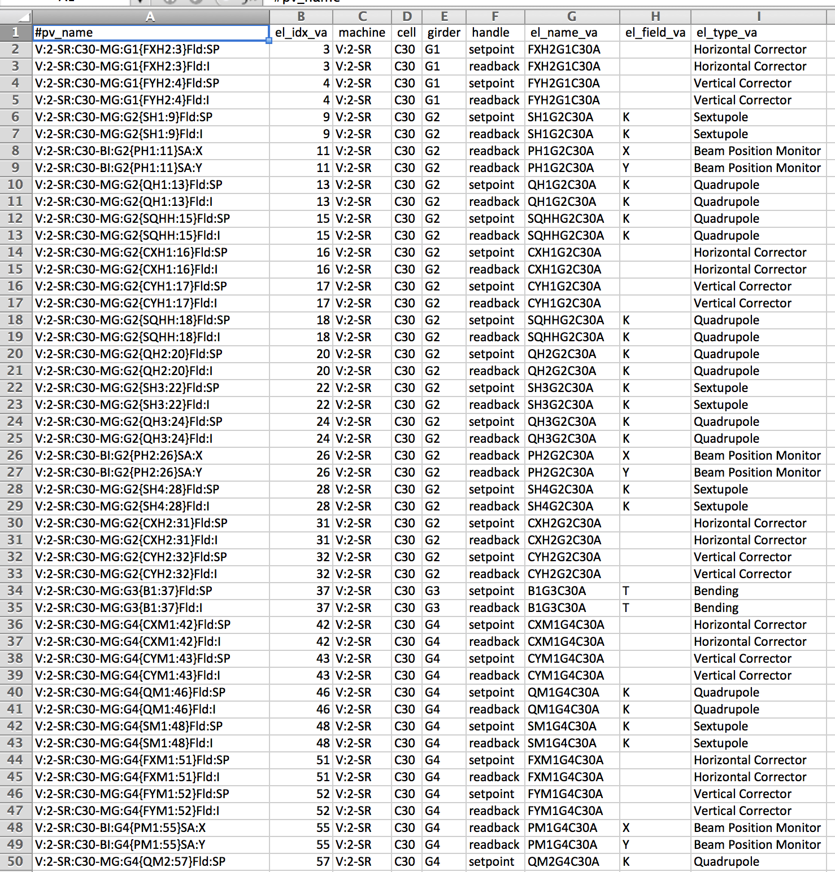
Virtual Accelerator
Automatic generate EPICS database
Load a lattice file in
Apply NSLS II naming conversion
Generate EPICS .db file
Generate cmd file to initialize each setting point PV
Generate a table to descript the property
for physics application
For channel finder services
Notes:
Table could be used to pop up properties in channel finder for each PV to enable minimum efforts to switch apps from va to real machine
More details could be in a ICALEPCS13 paper

Slide 14
EPICS V4 based Middle Layer Service
Ethernet
EPICS V4
MASAR
Python
SQLite/IRMIS
Distributed Front-Ends
CAS PVAS
Diag db
CAS PVAS
PS db
CAS PVAS
RF db
CAS PVAS
VA db
CAS
JMS Service
Physical Device
Physical Device
Physical Device
Physical Device
Tracy-III Simulation

Slide 15
EPICS V4 based Middle Layer Service
An international collaboration working group
Collaborative institutes
APS
BNL
COSYLAB
DLS
PSI
SLAC
ESS
Weekly telecon meeting
A nominal 4 months face-face meeting rotating between the developer’s sites.

Slide 16
EPICS V4 based Middle Layer Service
An open source project for experimental facility
Extension of EPICS version 3
Complex data structure/data types
New communication protocol
Expanded to fitting the requirement
Physics middle layer server
Data acquisition
Experimental control
Other general service

Slide 17
EPICS V4 based Middle Layer Service
V4 Modules
Core modules:
pvData: fundamental data structure
pvAccess: communication protocol, carry data on wire
pvCommon: common utility library
Extensions
pvaSrv: EPICS Base IOC plugin interfacing V3 data to pvAccess
Normative type: collection of pvData data types that may be used for general purpose
Service modules:
Developed at each different site for its own purpose
Language support
C++ & Java mainly
Python, but greatly behind because of short of man-power

Slide 18
EPICS V4 based Middle Layer Service
Interoperation with V3
Client Apps
Client Apps
Client Apps
Channel Access Client
Channel Access
pvAccess
pvAccess Client
Channel Access
pvAccess
Channel Access
pvaSrv
Channel Access
EPICS Database
V4 processing engine
Device Support
pvData
Normative Type
Device Driver

Slide 19
EPICS V4 based Middle Layer Service
Communication Mechanisms
Get, Put, Monitor, Command/Response, Broadcast, Multicast
Normative types:
NT(DBRTypes), NTImage, NTTable, NTMultichannelArray, NTNDArray, NTStatistics,
pvAccess
optimized to send large arrays and structured data.
pvaSrv
reference implementations of middle layer services for relational databases or continuous data sources
serves V3 channels from the EPICS process database as does Channel Access.

Slide 20
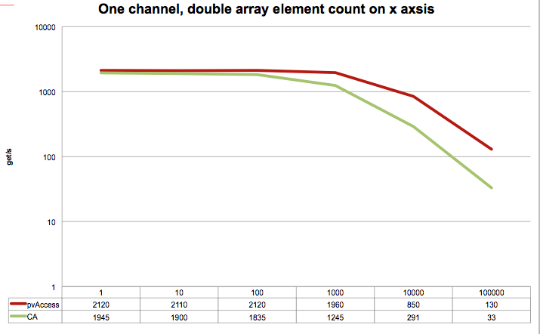
EPICS V4 based Middle Layer Service
pvAccess and Channel Access comparative performance (Number of channel value get operations per second), where only one channel's value is got in each get operation, as a function of array size of the channel
Courtesy of Matej Sekoranja
Notes:
The setup is C++ clients and servers, of the Beta 1.0.1 release (as on the downloads page), 2 MacBook Pros (~2GHz Intel Core Duo-s, 4GB memory) with a 1 GBit Ethernet point-to-point connection.

Slide 21
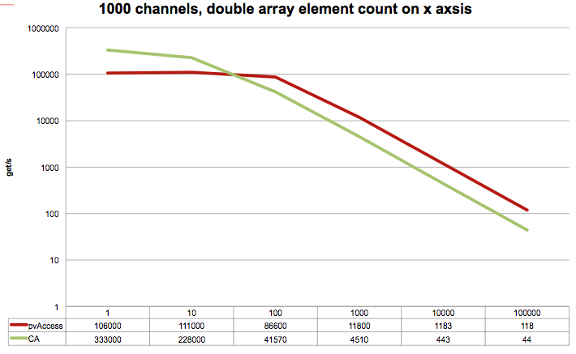
EPICS V4 based Middle Layer Service
pvAccess and Channel Access comparative performance (Number of channel value get operations per second), where 1000 channels values' are got in each get operation, as a function of array size of the channel.
Courtesy of Matej Sekoranja
Notes:
Some earlier performance benchmarking results could be found in BNL tech-report 82, and PAC11 conference paper, MOP252

Slide 22
EPICS V4 based Middle Layer Service
MASAR
Machine Snapshot, Archiving, and Retrieve
A general purpose tool to snapshot data from V3 PVs
Implemented in V4
Machine
A facility controlled by EPICS, accelerator for example
Snapshot
Data at specific time point
Value, time stamp, connection status, alarm status, alarm severity
Similar tools, but different purpose
IOC automatic save & restore
IOC bumpless rebooting
Channel Archiving
Archive pre-defined configuration periodically
All data saved time serially

Slide 23
EPICS V4 based Middle Layer Service
MASAR Architecture
Scripting
CS-Studio/BOY
Others
(Matlab)
PyQt
Scripting
High Level Scripting API
Low Level Python Client Library pvAccess/channelRPC Client (C++)
pvAccess Client Library (Java)
pvAccess
pvAccess/channelRPC
Service Engine
DSL-PY Module
Gather/C++
PYMASAR
(SQLite)
Channel Access
IOC
IOC
IOC
Finished
User Apps
Planning
Developing

Slide 24
EPICS V4 based Middle Layer Service
Snapshot configuration
EPICS V3 PV orientated
Support all scalar and waveform PV types
Float, double, string, and enum
PV group
Collection of PV names
Can be a mix of any of the types
One PV can be in many PV groups
Configuration
Collection of PV groups, therefore, collection of PV names
One PV group can be in many configurations
Snapshot
An event happened at a particular time
Belongs to one configuration
One configuration can have many events
Each event is one data set
Header information + meta data (value, time stamp)
Notes:
With a pre-defined configuration, a client can request MASAR to take a machine snapshot. Once the service engine gets a request, it retrieves the PV list for given configuration from SQLite, requests Gather library (a local Channel Access library implemented in C++ to gather PV data) to get data for each PV, and saves data into RDB via PYMASAR. In addition to the value, the connection status, time stamp, alarm severity, and alarm status for each PV is also saved.

Slide 25
EPICS V4 based Middle Layer Service
Snapshot configuration
Snapshot
pv
pv group
configuration
event
event data
...

Slide 26
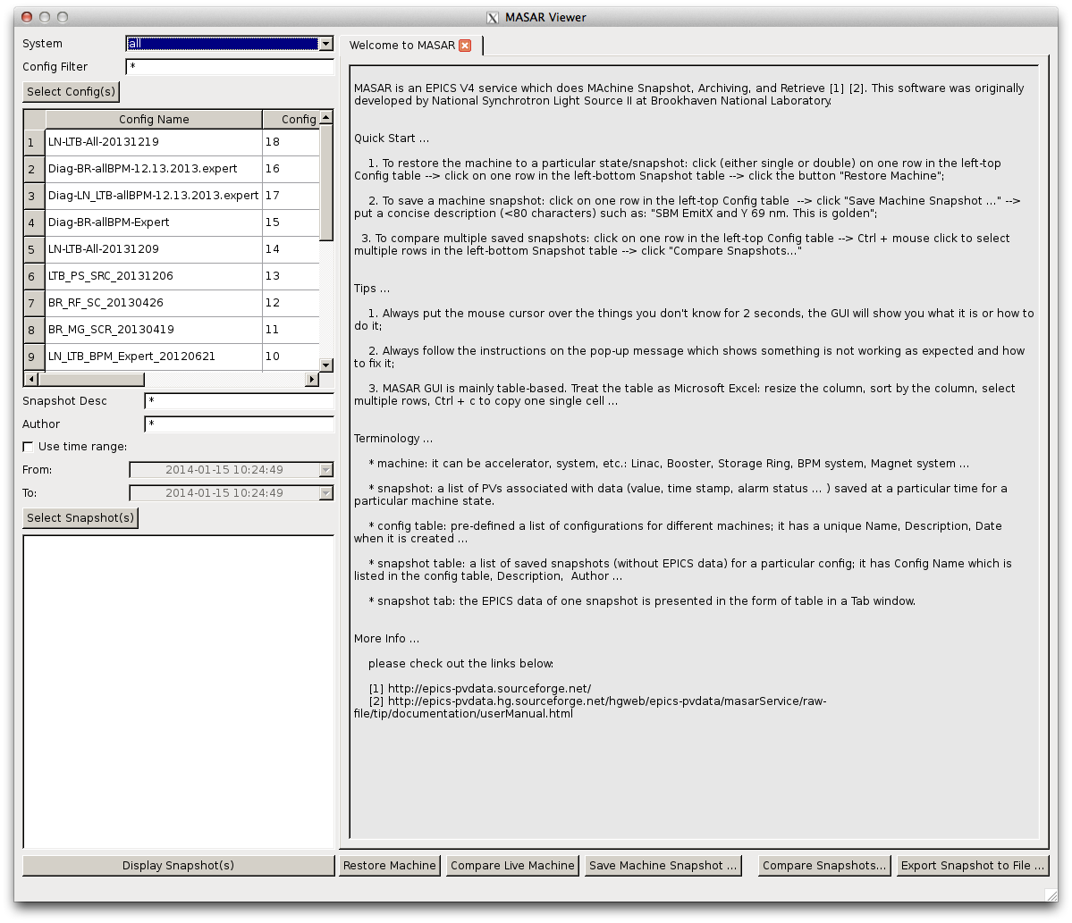
EPICS V4 based Middle Layer Service
UI PyQt4 based graphic user interface
Browse configuration
Browse event
Take snapshot
Retrieve data
Compare data
Restore machine
Export data to external file

Slide 27
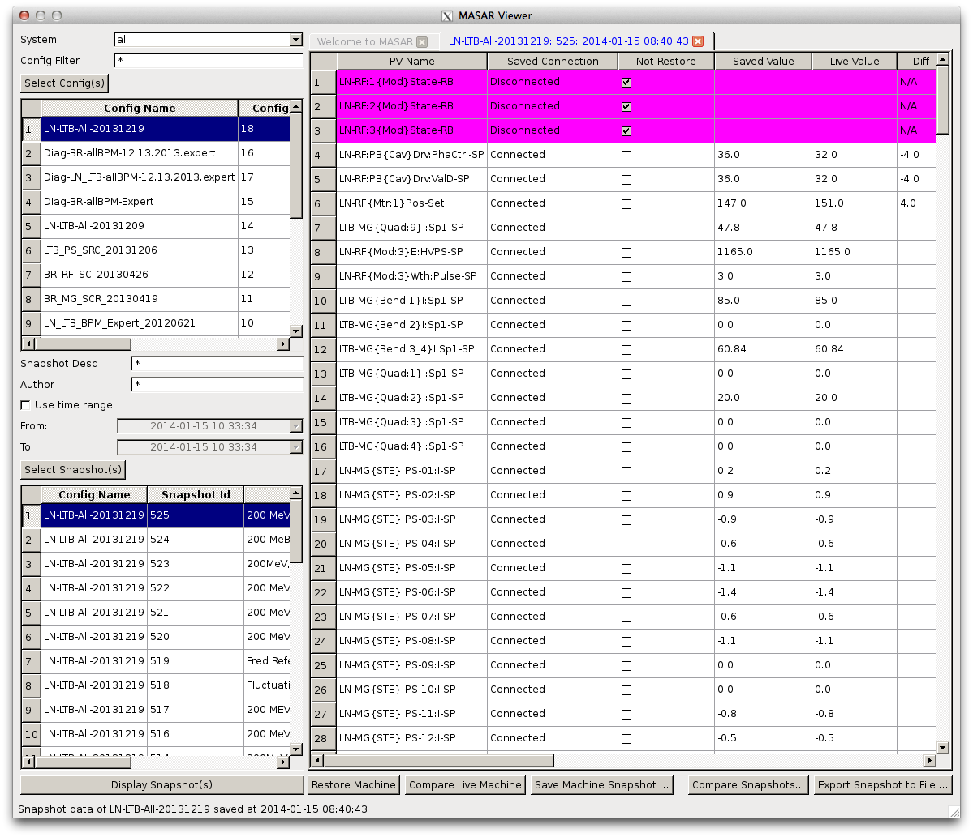
EPICS V4 based Middle Layer Service
Event data browsing and comparing with live machine
Notes:
Plot waveform data of a cell
Plot multiple data cells of a PV
Plot multiple data cells of selected PVs
Plot all cells of a PV
Plot all cells of selected PVs

Slide 28
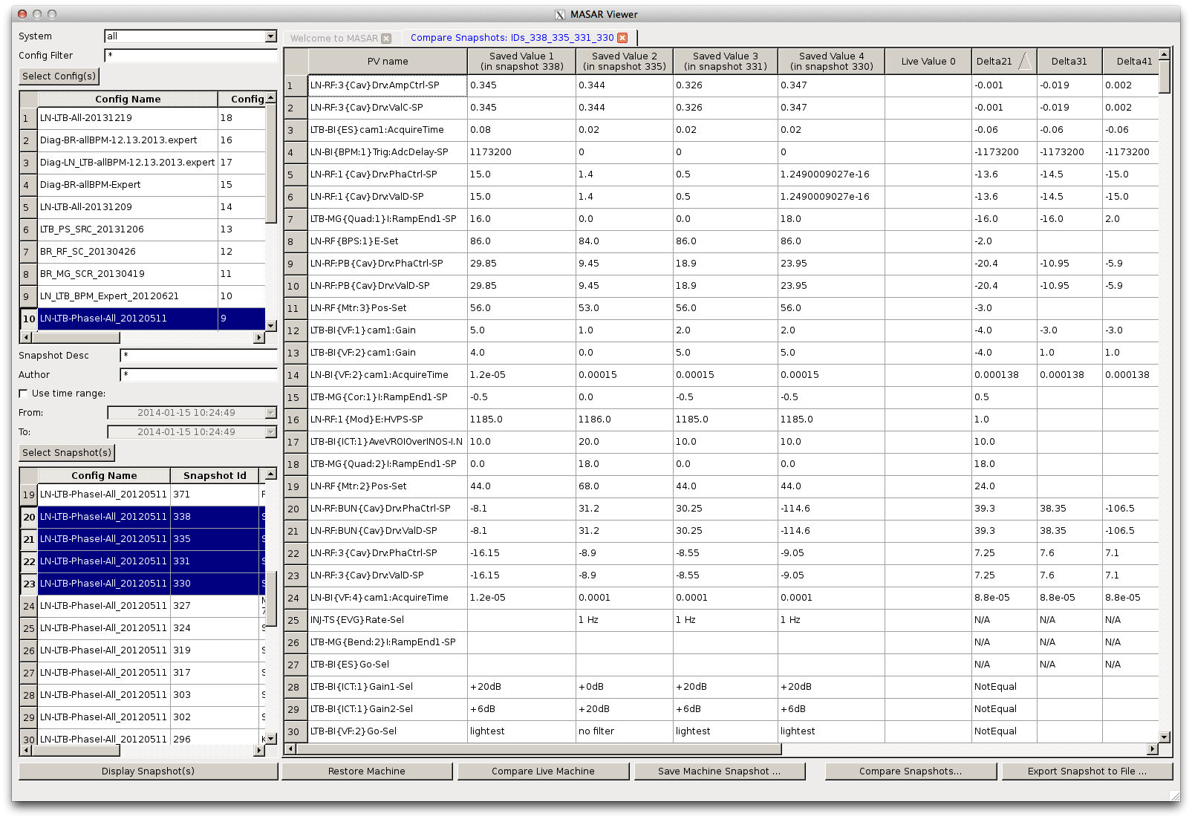
EPICS V4 based Middle Layer Service
Multiple data sets comparison
Support up to 9 data sets
Notes:
User select data set to be compared
Select reference data set from a pop up dialog
By default, first selected data as reference set

Slide 29
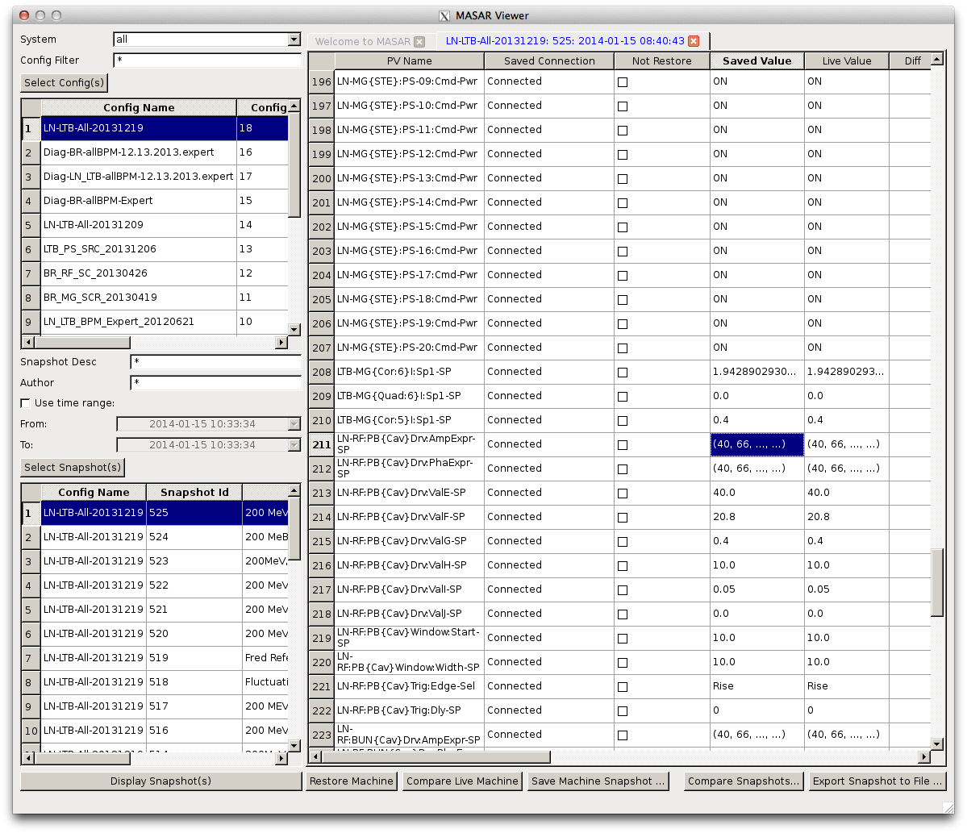
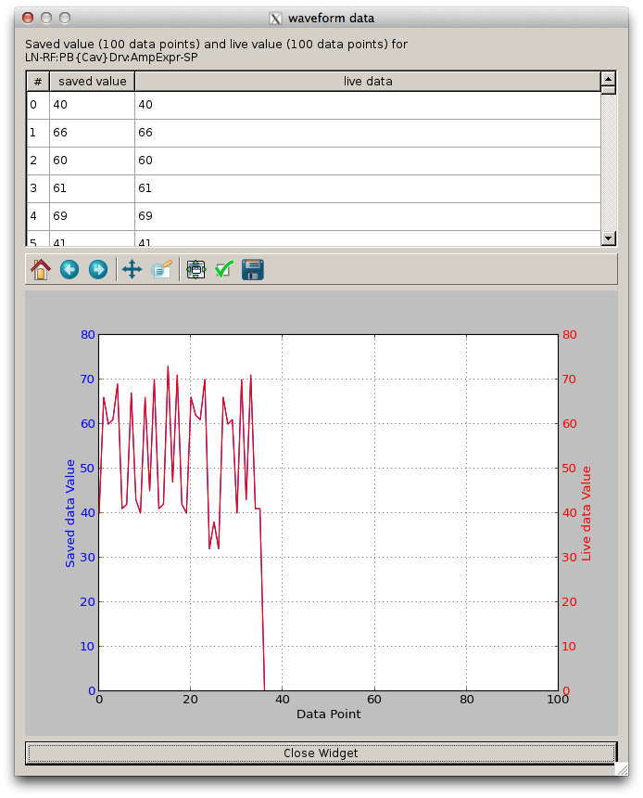
EPICS V4 based Middle Layer Service
Waveform data
Notes:
Plot waveform data of a cell
Plot multiple data cells of a PV
Plot multiple data cells of selected PVs
Plot all cells of a PV
Plot all cells of selected PVs

Slide 30
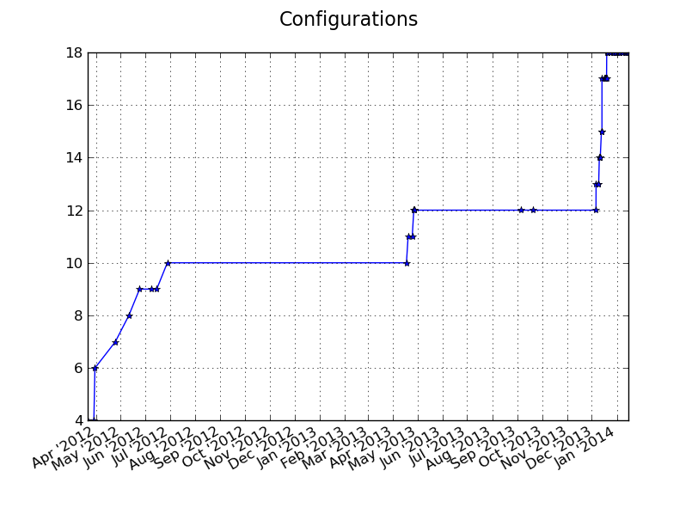
EPICS V4 based Middle Layer Service
Deployed in control network from the first day (3/27/2012)
Configuration increasing over time (by Jan 15 2014 10:51 AM)

Slide 31
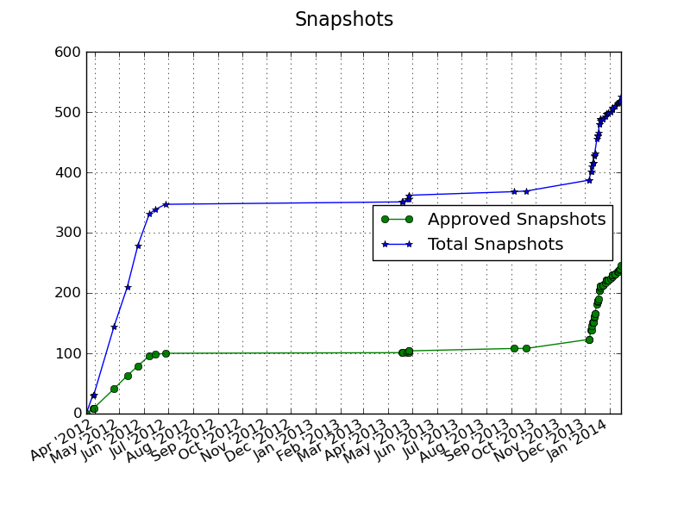
EPICS V4 based Middle Layer Service
Snapshots taken over time (by Jan 15 2014 10:51 AM)
Notes:
362 snapshots taken, and 104 snapshots good
MASAR allows user to preview a saved data set to make sure the data set is exact what is desired. By default, MASAR flags a data set as not approved. User has to explicitly approve one data set as good.

Slide 32
EPICS V4 based Middle Layer Service
Snapshots taken with time
Events (by Jan 15 2014 10:51 AM) total taken: 525, approved: 246
Regular snapshot per shift
Date | Snapshots taken | Snapshots Approved
2012-03-21 9:28 | 0 | 0
2012-03-29 10:32 | 30 | 8
2012-03-30 18:01 | 31 | 9
2012-04-24 20:02 | 144 | 41
2012-05-11 10:27 | 210 | 63
2012-05-24 14:25 | 279 | 79
2012-06-07 18:28 | 331 | 96
2012-06-14 16:13 | 338 | 98
2013-12-17 7:34 | 460 | 186
2013-12-20 16:01 | 488 | 212
2013-12-23 14:48 | 489 | 213
2013-12-26 18:40 | 493 | 217
2013-12-27 18:18 | 497 | 221
2013-12-30 13:54 | 498 | 222
2014-01-02 12:12 | 500 | 224
2014-01-14 2:29 | 519 | 240
2014-01-15 8:40 | 525 | 246
Notes:
362 snapshots taken, and 104 snapshots good
MASAR allows user to preview a saved data set to make sure the data set is exact what is desired. By default, MASAR flags a data set as not approved. User has to explicitly approve one data set as good.

Slide 33
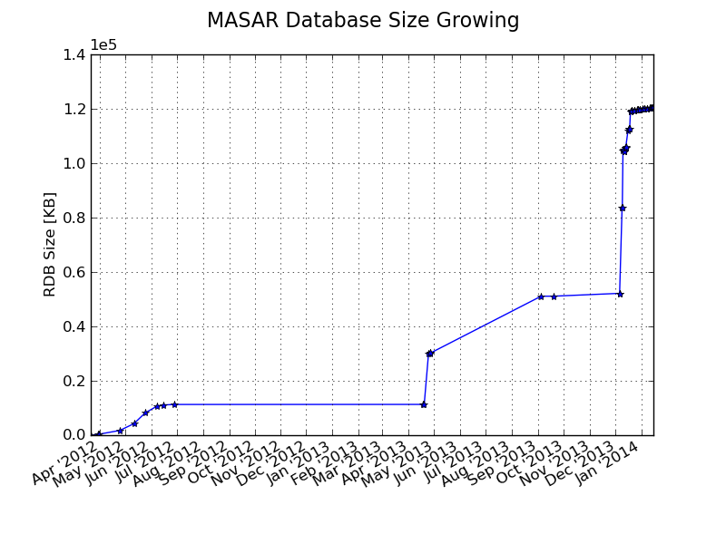
EPICS V4 based Middle Layer Service
Database size growing over time (by Jan 15 2014 10:51 AM)
Notes:
The file size was taken during regular maintenance. Therefore, there might have more than one snapshot at each time point, or does not have anything.
2 significant size increases. Caused by 5 snapshots for power supply ramping table of booster ring. That configuration contains over 60 PVs for booster ring power supplies, and each PV is a waveform with over 10,000 points.

Slide 34
RESTful based Middle Layer Services
Ethernet
EPICS V4
MASAR
Python
PVAS
HTTP/REST
MUNICONV
Python
PVAS
HTTP/REST
Lattice/Model
Python
PVAS
HTTP/REST
Channel Finder
Java
PVAS
HTTP/REST
Olog
Java
SQLite/IRMIS
MySQL/IRMIS
MySQL/IRMIS
MySQL
MySQL
Distributed Front-Ends
CAS PVAS
Diag db
CAS PVAS
PS db
CAS PVAS
RF db
CAS PVAS
VA db
CAS
JMS Service
Physical Device
Physical Device
Physical Device
Physical Device
Tracy-III Simulation

Slide 35
RESTful based Middle Layer Services
Channel finder services
Originally by Ralph Lange
Channel name look-up service
Support property (name-value pair)
Support tags
Automatically load EPICS Channels at IOC initialization
Client support
Python library
CS-Studio
J2EE service
MySQL as RDB backend

Slide 36
RESTful based Middle Layer Services
Channel finder
update daemon
/cf-update
IOCs
NFS
Web proxy
Glassfish Web service
CSS
Scripts to - populate properties
dependency
data flow

Slide 37
RESTful based Middle Layer Services
Virtual accelerator property into channel finder
Channel Name | V2:SR:C02-MG:G04A{HFCor:FM1} |  | V2:SR:C02-MG:G04A{VFCor:FM1}
 | Fld-I | Fld-SP | Fld-I | Fld-SP
handle | READBACK | SETPOINT | READBACK | SETPOINT
elemName | FXM1G4C02A |  | FYM1G4C02A
elemType | HFCOR |  | VFCOR
elemField | x |  | y
devName | FM1G4C02A
sEnd | 65.5222
cell | C02
girder | G4
symmetry | A
length | 0.044
ordinal | 263 |  | 264
tags | eget | eput | eget | eput
 | x |  | y
 | sys.SR
Notes:
Value are generated from the property table when generating VA EPICS DB

Slide 38
RESTful based Middle Layer Services
Olog
Collaboration by NSLS II@BNL & FRIB@MSU
Log an entry
Time, owner, text, attachments, logbooks, tags, properties
J2EE service
MySQL as RDB backend
Client support
Python library
CS-Studio
Web interface

Slide 39
Publish/subscribe
Command/response
v3
v4
IOC
IOC
…
IOC
IOC
…
v4
CA client (JCA/CAJ)
pvA client
Masar
…
Core Client Technologies
Data Sources
CA
Sim
Test
pvA
Aggregation
pvManager
AccelUtils
Java/Python
Web based REST services
Data Definition
vTypes
API
ChannelFinder
API
ChannelFinder
Visualization
Graphene
API
Olog
CSS Core
ChannelFinder Integration
ChannelFinder Integration
Olog Integration
…
...
Log Viewer
BEAST
BOY
Web UI and other clients
Scripts and utilities
DataBrowser
Courtesy of Kunal Shroff
Logbook
pyOlog
…
CS-Studio
…
…
Notes:
To begin with this slides gives an overview of the various pieces that represent the architecture of our controls and high level physics applications, tools and services along and their relation ship with each other.
// maybe
Epics (both v3 and v4) is the control system we use
The core technologies provide the means to efficiently communicate with the Control system
CS-Studio is our primary user interface tool

Slide 40
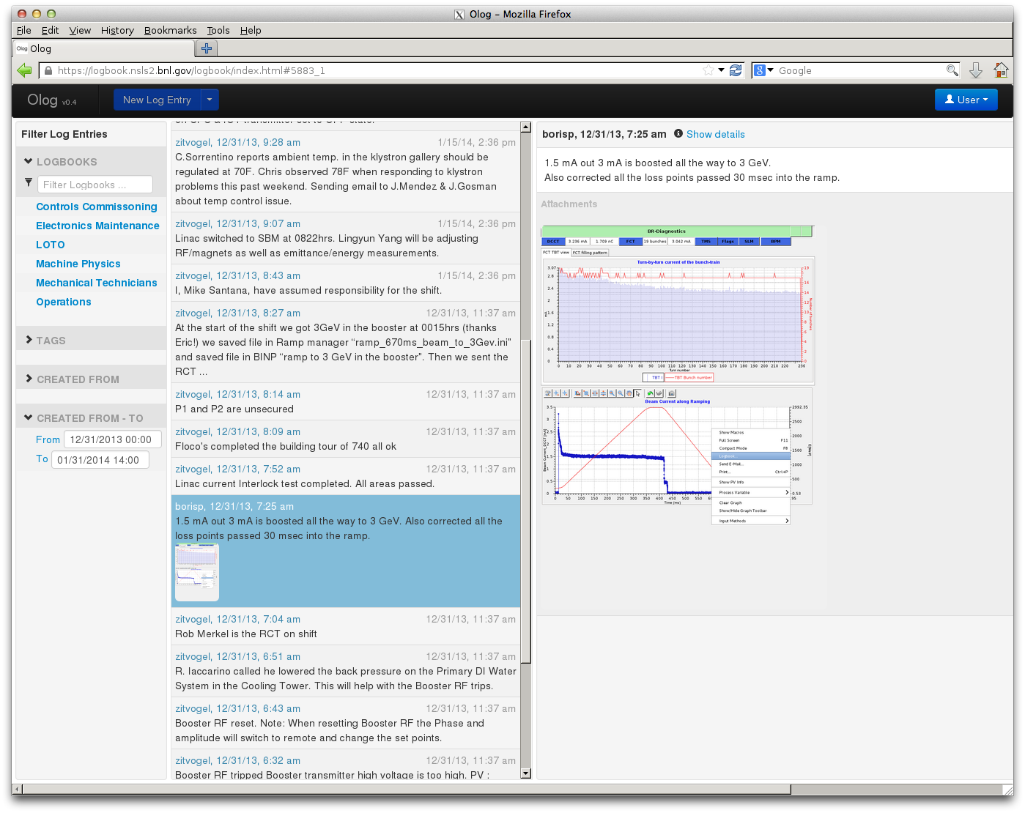
RESTful based Middle Layer Services
Olog web view

Slide 41
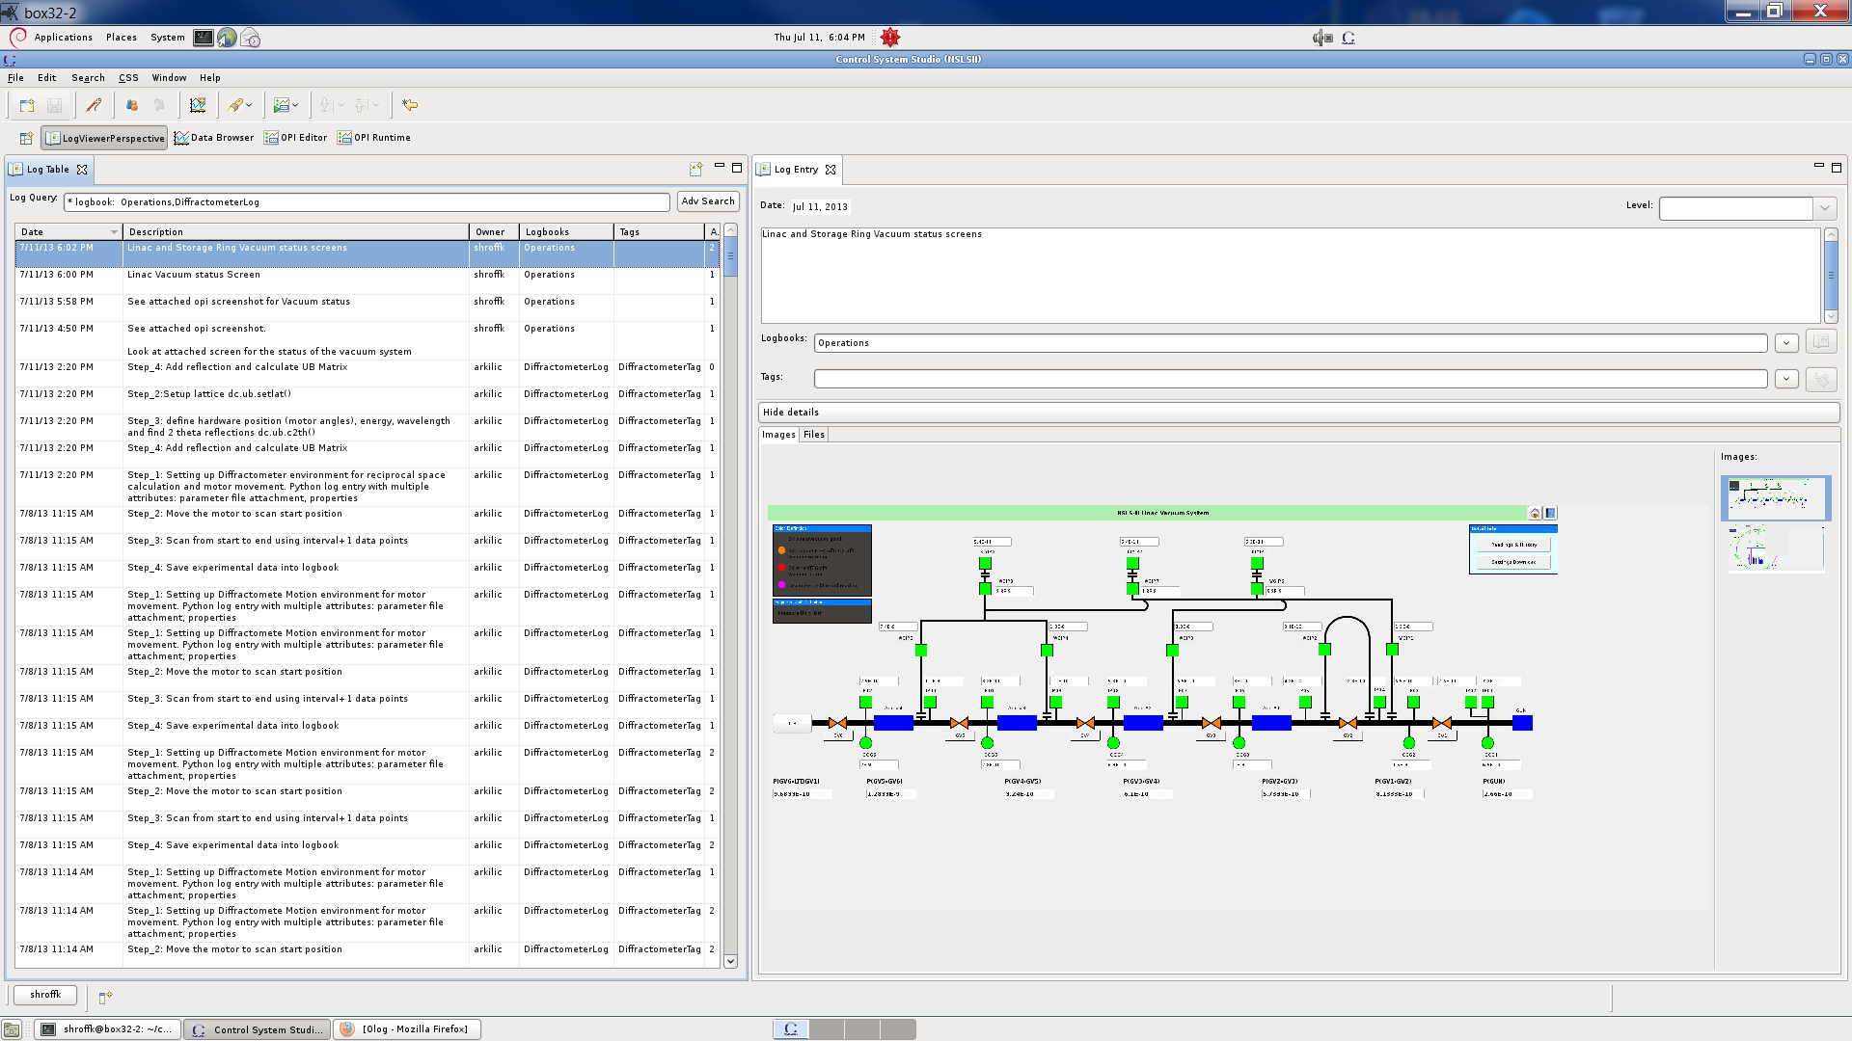
RESTful based Middle Layer Services
Olog CS-Studio view

Slide 42
RESTful based Middle Layer Services
Lattice and Model Service
Beam Parameter
Beam Parameter
Lattice Deck
Beam Parameter
Beam Parameter
Simulation/ Measurement
Lattice
(Geometric + Strength)
Model
(Simulation output)

Slide 43
RESTful based Middle Layer Services
Lattice Model Service Architecture
Scripting
CSS/BOY
Others
(Matlab)
Python Client
Java Client
Browsers
RESTful
pvAccess
RESTful
pvAccess
RESTful
pvAccess
V4 channelRPC service
HTML
Simulation
(Tracy-III & Elegant)
Django
Data Processing API
Python Data API
Python-MySQLdb
MySQL (Lattice: geo+strength, Model: TWISS, T-Matrix, Close Orbit, …)
Finished
User Apps
Planning
Developing

Slide 44
RESTful based Middle Layer Services
Service implemented under Django framework
Provide REST service interface
Currently, support RESTful GET & POST
3 lattice deck acceptable
Predefined tab-separated plain lattice
Tracy-3
Elegant
2 simulation codes support by server
Tracy-3 & elegant
Client support
Python library
Web UI
MySQL as RDB backend
V4 implementation has been planned on top

Slide 45
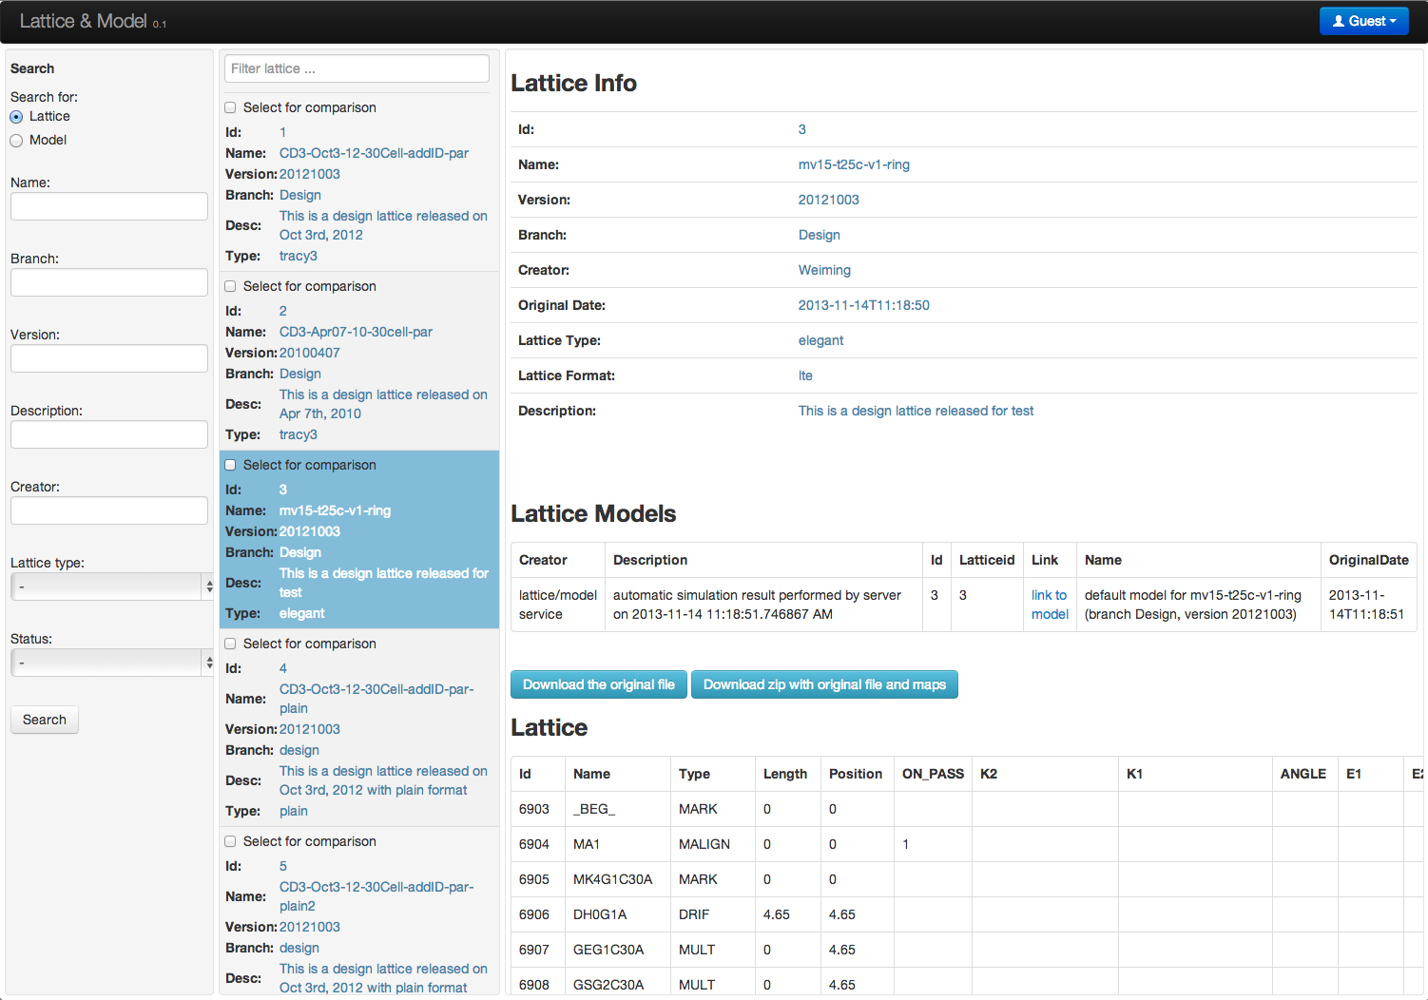
RESTful based Middle Layer Services
Lattice view

Slide 46
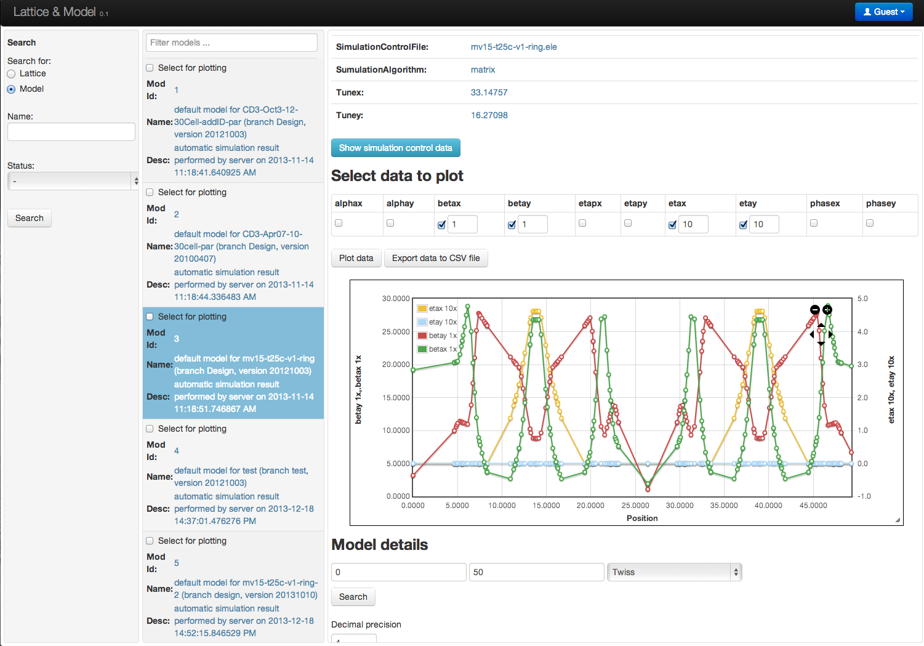
RESTful based Middle Layer Services
Model view

Slide 47
RESTful based Middle Layer Services
MUNICONV Service
Multiple unit conversion
First implementation targeting on magnets
Convert value between different unit systems
i: power supply current
b: magnetic fields
k: value in model/lattice domain
RESTful service interface under Django
Currently, support GET method
MySQL as RDB backend
Client support
Python library
Web UI
V4 implementation has been planned on top

Slide 48
RESTful based Middle Layer Services
MUNICONV Architecture
Scripting
CSS/BOY
Others
(Matlab)
Python Client
Java Client
Browsers
RESTful
pvAccess
RESTful
pvAccess
RESTful
pvAccess
V4 channelRPC service
HTML
Django
V3 IOC
Conversion functions
Python Data API
Conversion functions
Python-MySQLdb
MySQL (Lattice: geo+strength, Model: TWISS, T-Matrix, Close Orbit, …)
Finished
User Apps
Planning
Developing

Slide 49
RESTful based Middle Layer Services
MUNICONV Data stored in RDB
Capture interested raw data
Measurement data, fitting parameters, fitting algorithm
Serial #, device name, installation info
Component type
Measurement data
For each individual magnet
For magnet type

Slide 50
RESTful based Middle Layer Services
MUNICONV Capability
Convert value between predefine unit system
Unit is determined usually by magnet measurement
Conversion algorithm plugable
MUNICONV Support magnets
Standalone function magnet
Function combined magnet
A skew quadrupole with H&V correctors for example
Serial powered magnet chain

Slide 51
RESTful based Middle Layer Services
Pluggable and extendable conversion algorithm
{'i2b': {'auxInfo': 1,
'function': '',
'algorithmId': 1,
'initialUnit': '',
'resultUnit': ''},
'b2i': {'auxInfo': 1,
'function': '',
'algorithmId': 1,
'initialUnit': '',
'resultUnit': ''},
'b2k': {'auxInfo': 2,
'function': '',
'algorithmId': 0,
'initialUnit': '',
'resultUnit': ''},
…
}
# auxInfo: an additional information,
# could be used for example the fitting order
# of polynomial fitting,
# 0: not use; 1: linear fit; 2: 2nd order poly fit; ...
# or the order of fitting result, for example
# 1: kick angle, rad/degree;
# 2: K1, 1/m2;
# 3: K2, 1/m3;
# 4: K3, 1/m4; ...
# algorithmId: id to show which algorithm to use,
# 0: linear fitting with given function
# 1: high order polynomial fitting with given function
# 2: polynomial fitting using raw data
# 3: interpolating with raw magnetic data
# 4: …

Slide 52
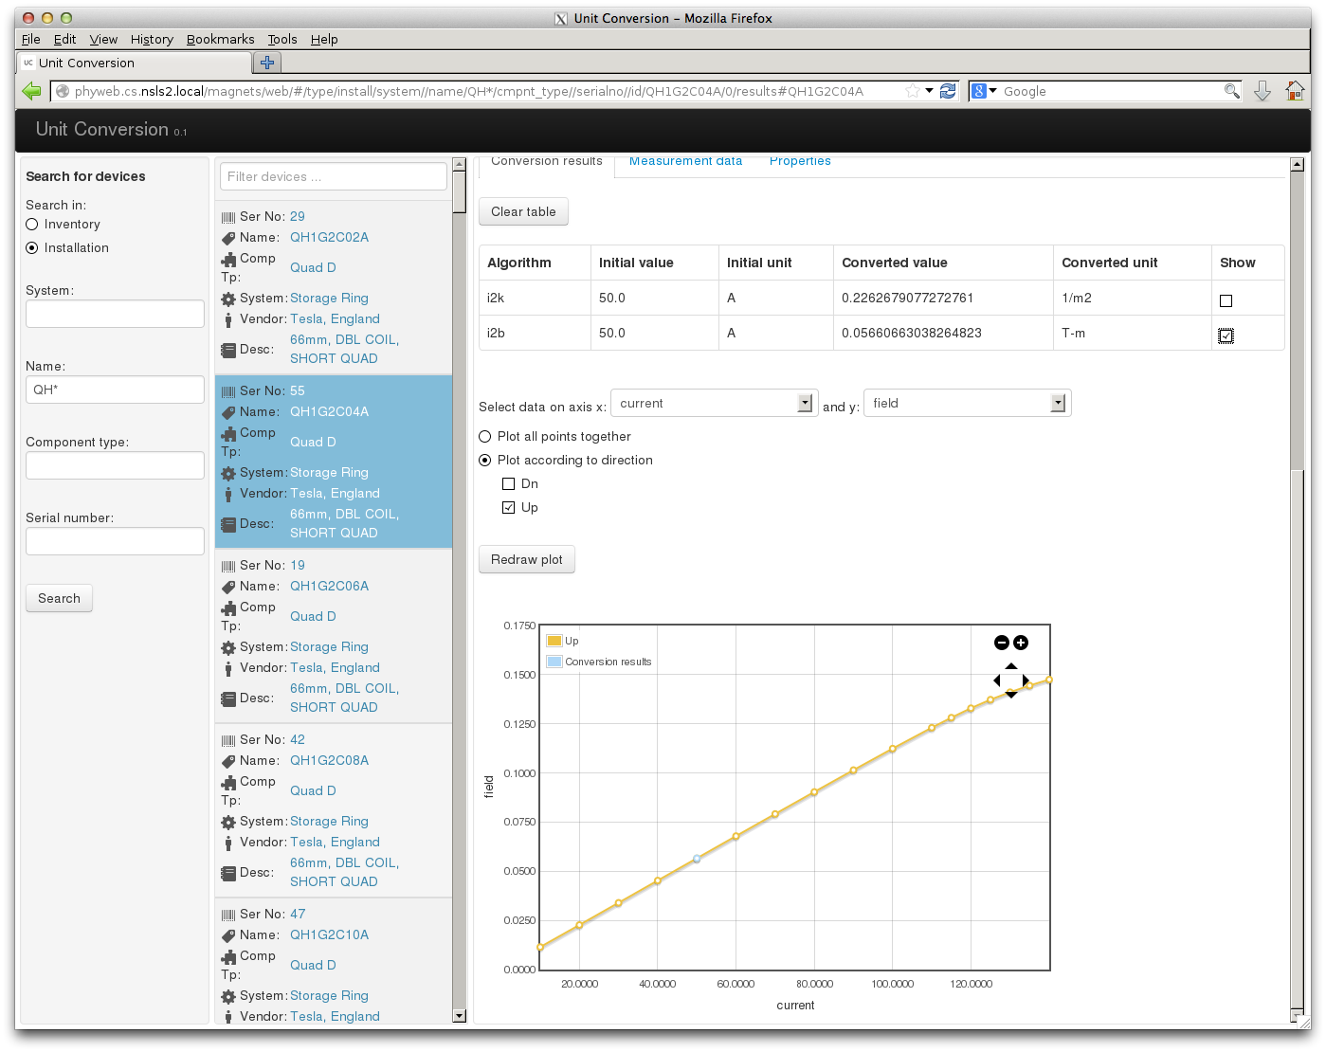
RESTful based Middle Layer Services
MUNICONV WEB View

Slide 53
RESTful based Middle Layer Services
IDOD service for insertion device
Data service to store both online data and offline data
Same architecture to be implemented using django
Under active development, and should be released soon
Data service for beam based fast interlock
Provide a data warehouse
Keep all history data
Under design

Slide 54
Middle Layer Services Integration
IOCs
(PVs in Phyisics Unit)
Client App
IOC
MASAR
Channel Finder
Lattice/Model
Other Service
(IDOD)
MUNICONV

Slide 55
Beam Commissioning
High Level Applications
CS-Studio
pvManager
CAC PVAC REST
Python Apps
CAC PVAC REST
MMLT
CAC PVAC REST
Matlab Apps
CAC PVAC REST
Channel Arch
CAC PVAC REST
Ethernet
EPICS V4
MASAR
Python
PVAS
HTTP/REST
MUNICONV
Python
PVAS
HTTP/REST
Lattice/Model
Python
PVAS
HTTP/REST
Channel Finder
Java
PVAS
HTTP/REST
Olog
Java
PVAS
HTTP/REST
…
…
SQLite/IRMIS
MySQL/IRMIS
MySQL/IRMIS
MySQL
MySQL
MySQL
Distributed Front-Ends
CAS PVAS
Diag db
CAS PVAS
PS db
CAS PVAS
RF db
CAS PVAS
VA db
CAS
JMS Service
Physical Device
Physical Device
Physical Device
Physical Device
Tracy-III Simulation

Slide 56
Beam Commissioning
2013-11-27: restart beam commissioning
2013-11-29: accelerate to 200 MeV in single

Slide 57
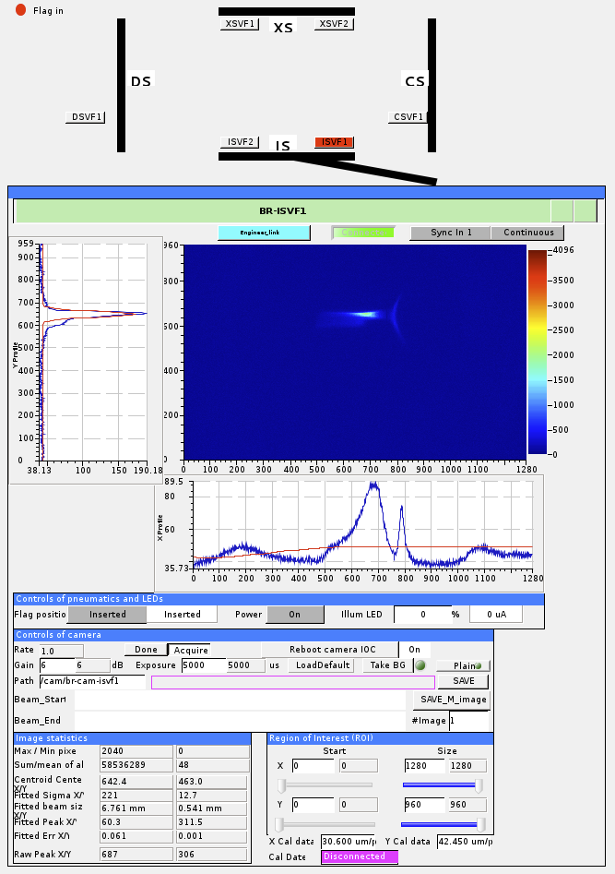
Beam Commissioning
2013-11-27: restart beam commissioning
2013-11-29: accelerate to 200 MeV in single
2013-12-07: injection into booster
2013-12-10: beam spinned the Booster Ring
Notes:
December 2, 2013: 24 hour commissioning starts.
December 5, 2013: Fault studies authorized and completed.
December 6, 2013: Fault study interim report approved. Injection into booster authorized.

Slide 58
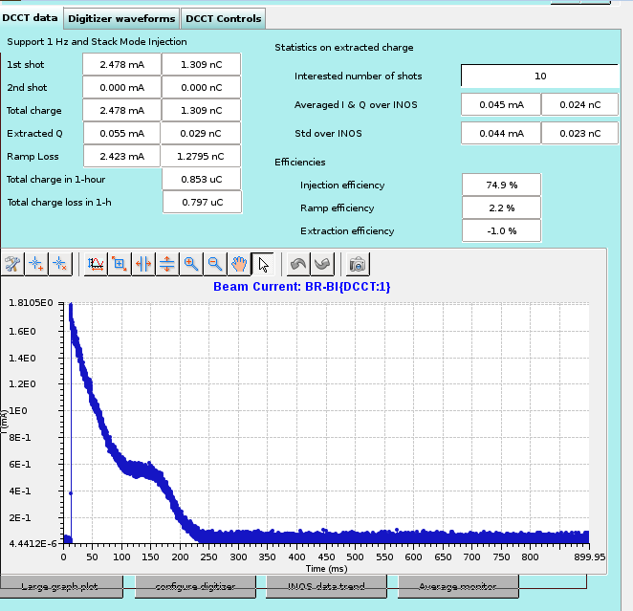
Beam Commissioning
2013-11-27: restart beam commissioning
2013-11-29: accelerate to 200 MeV in single
2013-12-07: injection into booster
2013-12-10: beam spinned the Booster Ring
2013-12-16: beam circulated tens of thousand turns in the booster ring

Slide 59
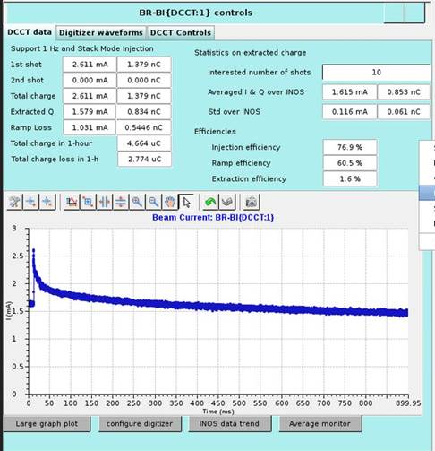
Beam Commissioning
2013-11-27: restart beam commissioning
2013-11-29: accelerate to 200 MeV in single
2013-12-07: injection into booster
2013-12-10: beam spinned the Booster Ring
2013-12-16: beam circulated tens of thousand turns in the booster ring
2013-12-21: beam captured by the booster RF

Slide 60
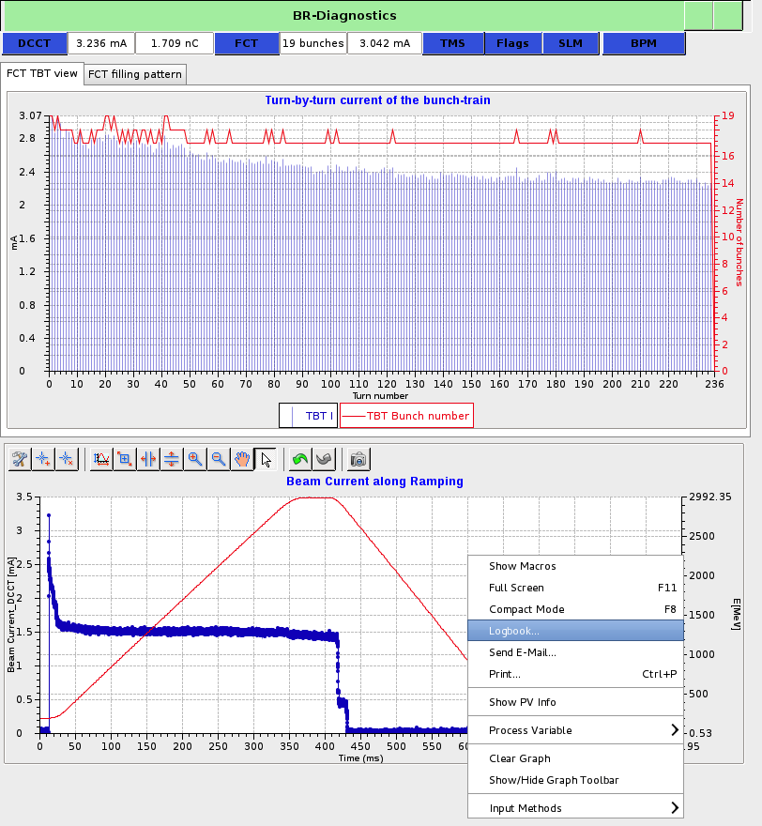
Beam Commissioning
2013-11-27: restart beam commissioning
2013-11-29: accelerate to 200 MeV in single
2013-12-07: injection into booster
2013-12-10: beam spinned the Booster Ring
2013-12-16: beam circulated tens of thousand turns in the booster ring
2013-12-21: beam captured by the booster RF
2013-12-31: beam boosted to 3 GeV (1.5 mA out 3 mA )

Slide 61
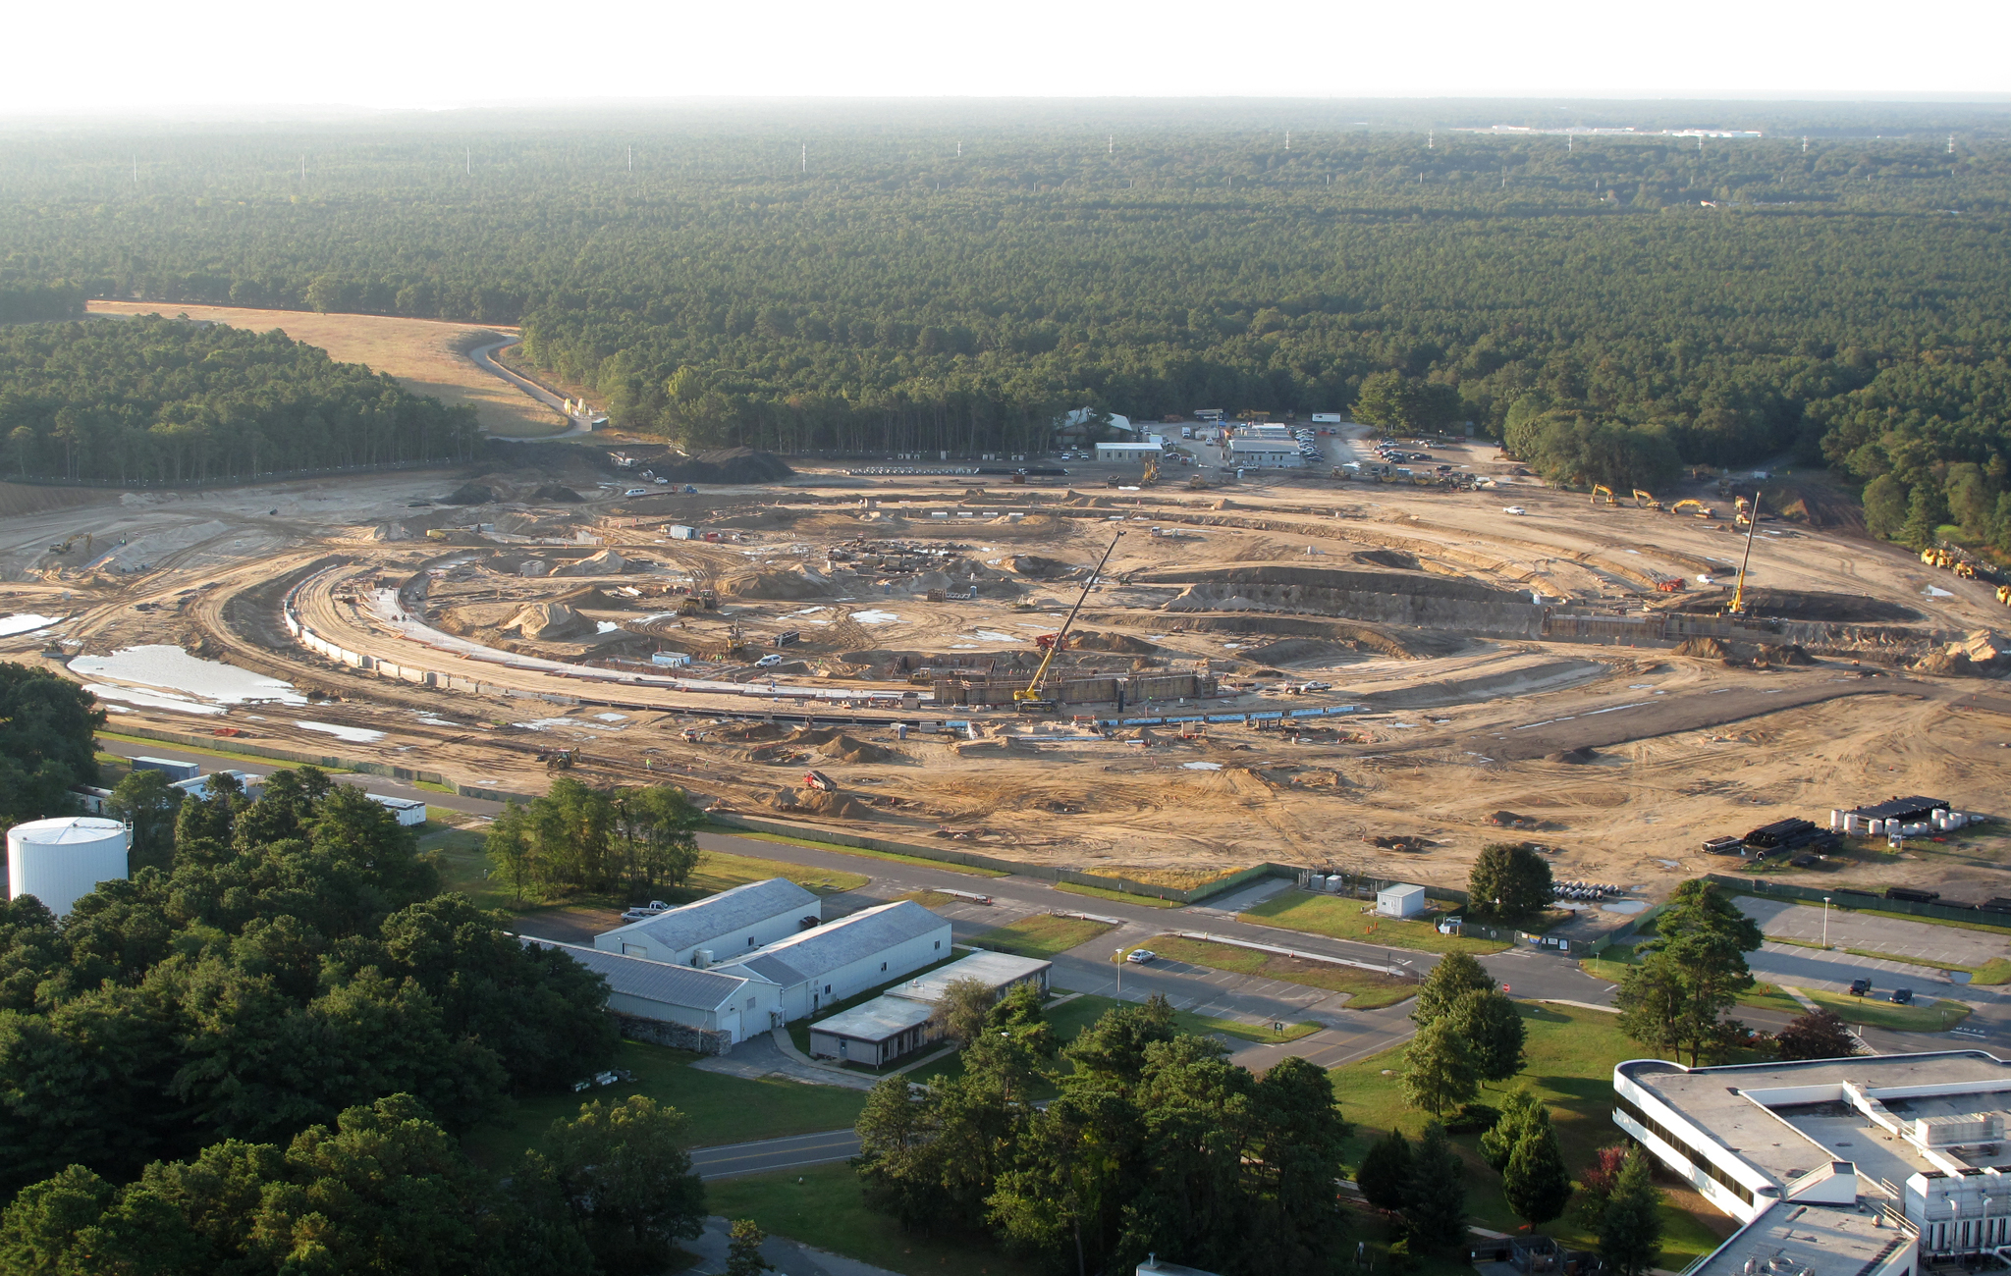
NSLS II Construction
Oct 2009

Slide 62
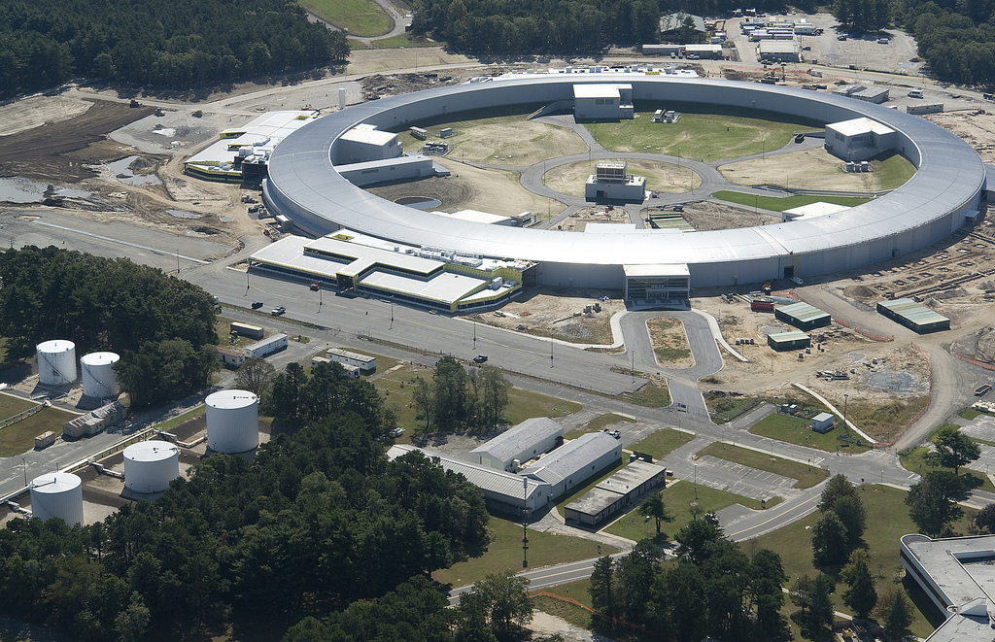
NSLS II Construction
Oct 2010

Slide 63
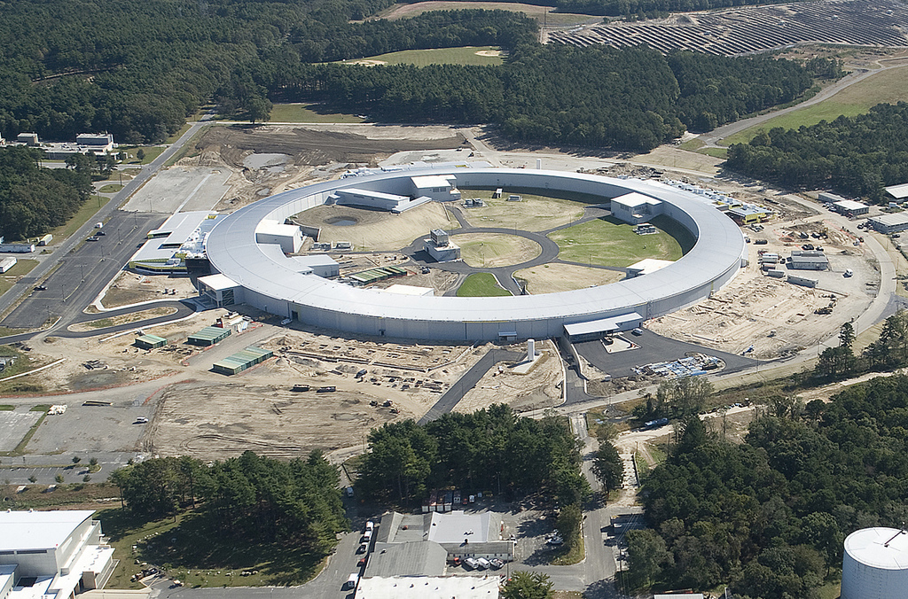
NSLS II Construction
Oct 2011

Slide 64
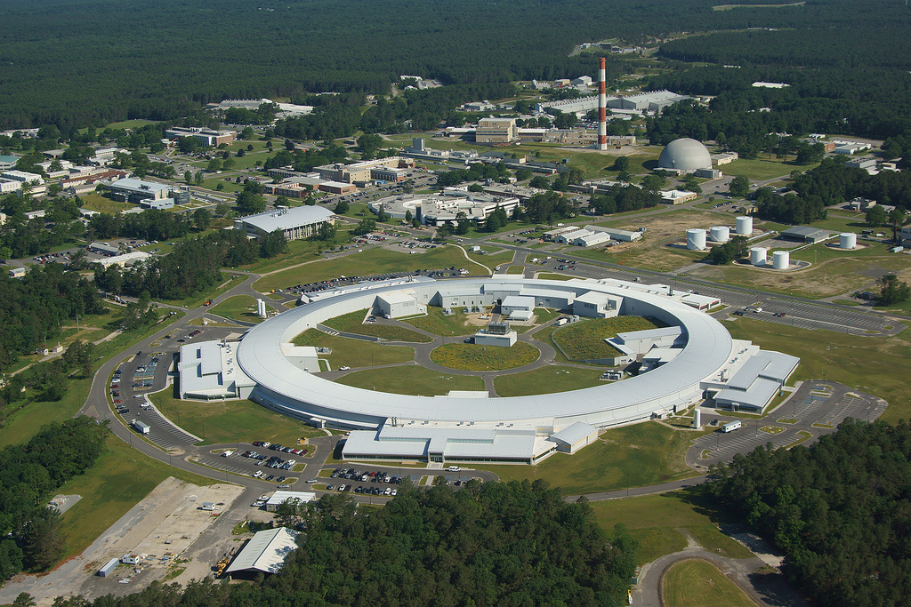
NSLS II Construction
Jul 2013
Control Room
Storage Ring
Controls Group
Booster
Linac

Slide 65
Conclusion
Overviewed NSLS II project
Virtual accelerator provided solid support
2 technologies for middle services
V4 service, and RESTful web services
Satisfy various requirement
Play critical role during commissioning
Support beam commissioning well
Beam to 3GeV on 2013-12-31

